Slide 1
Design and Analysis of Algorithms
CS602
Lecture 19
Network Flow – IV
Toward Polynomial time algorithm for Maximum Flow
Applications of Maximum Flow

Slide 2
RECAP of the last Lecture

Slide 3
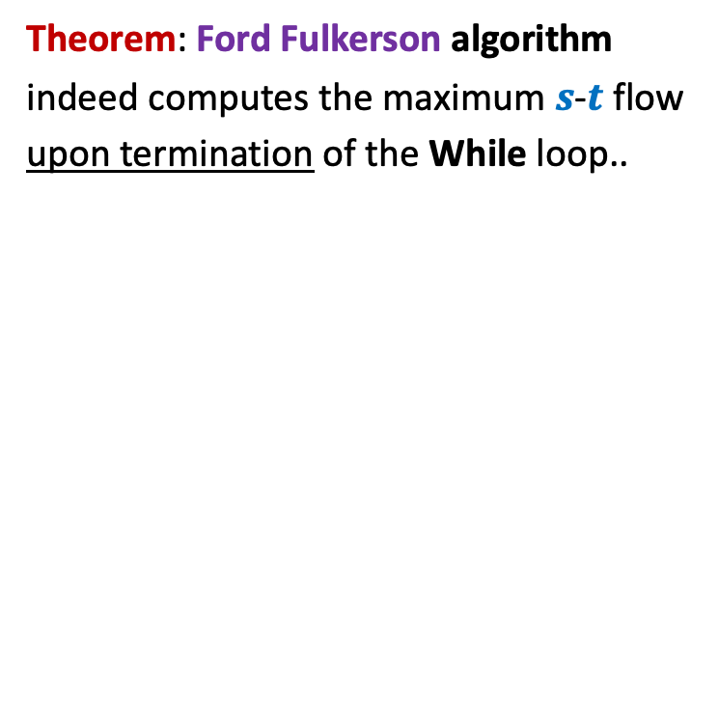
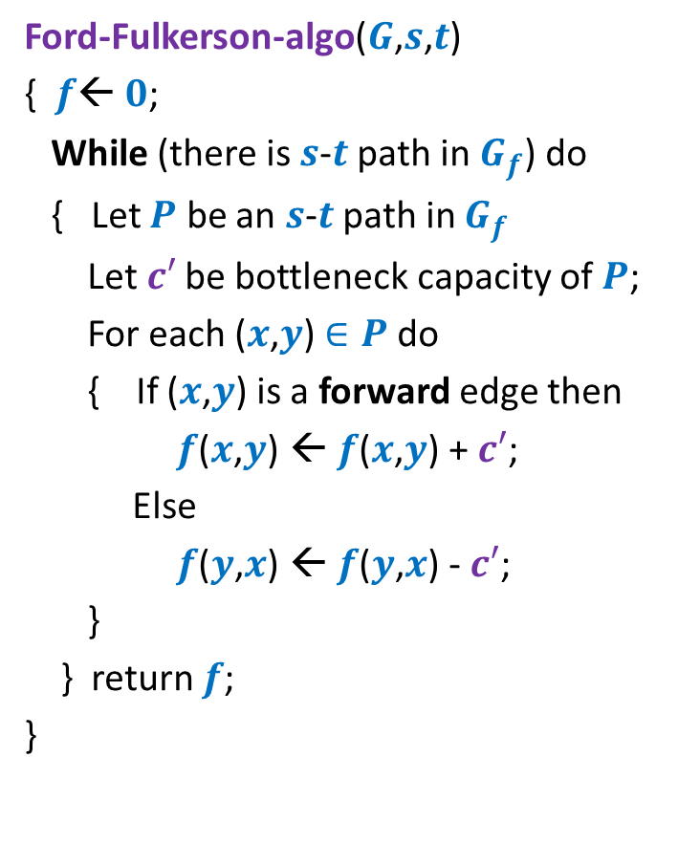
Ford Fulkerson algorithm
Ford-Fulkerson-algo($G$,$s$,$t$)
{ $f$← $0$;
While (there is $s$-$t$ path in $G_{f}$) do
{ Let $P$ be an $s$-$t$ path in $G_{f}$
Let$c′$ be bottleneck capacity of $P$;
For each ($x$,$y$) $∈P$ do
{ If ($x$,$y$) is a forward edge then
$f$($x$,$y$) ← $f$($x$,$y$) + $c′$;
Else
$f$($y$,$x$) ← $f$($y$,$x$) - $c′$;
}
} return $f$;
}
Theorem: Ford Fulkerson algorithm
indeed computes the maximum $s$-$t$ flow
upon termination of the While loop..

Slide 4

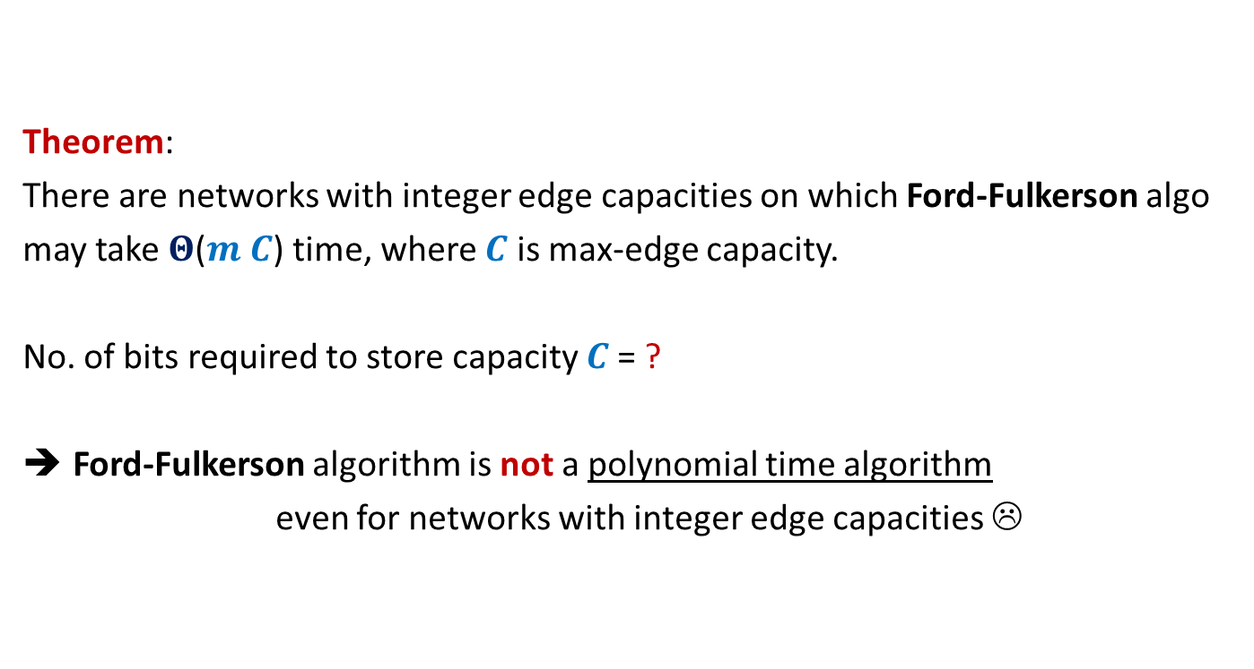
Theorem:
There are networks with integer edge capacities on which Ford-Fulkerson algo
may take $Θ$($m C$) time, where $C$ is max-edge capacity.
No. of bits required to store capacity $C$= ?
Ford-Fulkerson algorithm is not a polynomial time algorithm
even for networks with integer edge capacities ☹
$$\log_{2}C$$

Slide 5
Polynomial Time algorithms for max-flow
Algorithm 1 For Networks with integer capacities

Slide 6

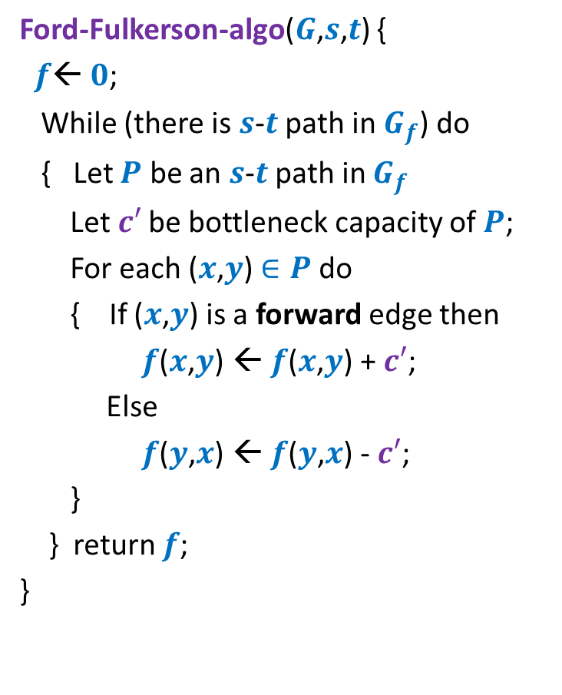

Algorithm 1
Algorithm-1($G$,$s$,$t$) {
Ford-Fulkerson-algo($G$,$s$,$t$) {
$f$← $0$;
While (there is $s$-$t$ path in $G_{f}$) do
{ Let $P$ be an $s$-$t$ path in $G_{f}$
Let$c′$ be bottleneck capacity of $P$;
For each ($x$,$y$) $∈P$ do
{ If ($x$,$y$) is a forward edge then
$f$($x$,$y$) ← $f$($x$,$y$) + $c′$;
Else
$f$($y$,$x$) ← $f$($y$,$x$) - $c′$;
}
} return $f$;
}
Assignment 4
Insight from
MaxFlow-MinCut Theorem.
Let $P$ be the max-capacity $s$-$t$ path in $G_{f}$;

Slide 7
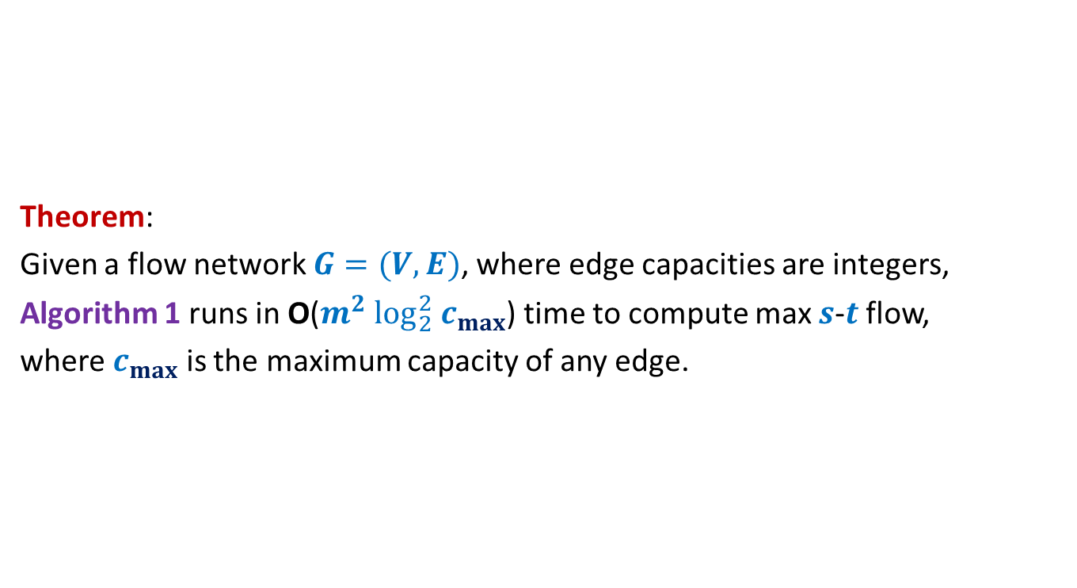
Algorithm 1
Theorem:
Given a flow network $G=(V,E)$, where edge capacities are integers,
Algorithm 1 runs in O($m^{2} \log_{2}^{2} c_{max}$) time to compute max $s$-$t$ flow,
where $c_{max}$ is the maximum capacity of any edge.

Slide 8

Polynomial Time algorithm for max-flow
Algorithm 2
For Networks with edge capacities $∈R^{+}$

Slide 9




Ford Fulkerson Algorithm
Ford-Fulkerson-algo($G$,$s$,$t$) {
$f$← $0$;
While (there is $s$-$t$ path in $G_{f}$) do
{ Let $P$ be an $s$-$t$ path in $G_{f}$
Let$c′$ be bottleneck capacity of $P$;
For each ($x$,$y$) $∈P$ do
{ If ($x$,$y$) is a forward edge then
$f$($x$,$y$) ← $f$($x$,$y$) + $c′$;
Else
$f$($y$,$x$) ← $f$($y$,$x$) - $c′$;
}
} return $f$;
}
Suppose each ($x_{0}$,$y_{0}$)is the bottleneck edge.
$$c′$$
$$x_{0}$$
$$y_{0}$$

Slide 10
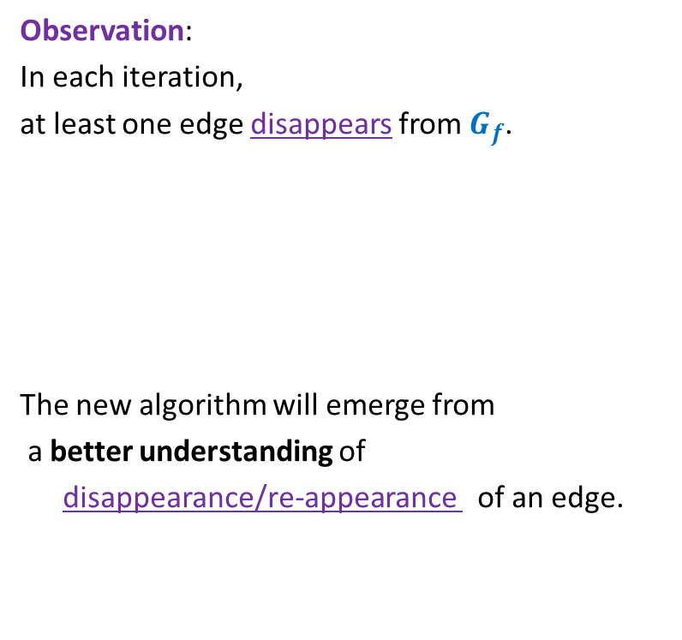

Ford Fulkerson Algorithm
Ford-Fulkerson-algo($G$,$s$,$t$) {
$f$← $0$;
While (there is $s$-$t$ path in $G_{f}$) do
{ Let $P$ be an $s$-$t$ path in $G_{f}$
Let$c′$ be bottleneck capacity of $P$;
For each ($x$,$y$) $∈P$ do
{ If ($x$,$y$) is a forward edge then
$f$($x$,$y$) ← $f$($x$,$y$) + $c′$;
Else
$f$($y$,$x$) ← $f$($y$,$x$) - $c′$;
}
} return $f$;
}
Observation:
In each iteration,
at least one edge disappears from $G_{f}$.
The new algorithm will emerge from
a better understanding of
disappearance/re-appearance of an edge.
But it may appear in $G_{f}$ again.

Slide 11

Disappearance of an edge in $G_{f}$

Slide 12














Disappearance of a forward edge
Flow must have increased along edge ($x$,$y$) up to $c$($x$,$y$).
➔ ($x$,$y$) must belong to the path $P$ selected during $i$th Iteration.
$$x$$
$$y$$
$$s$$
$$t$$
$$G_{f}$$
$$x$$
$$y$$
After $i$th Iteration
$$x$$
$$y$$
$$s$$
$$t$$
$$G_{f′}$$
$$x$$
$$y$$

Slide 13







Disappearance of a backward edge
Flow must have decreased along edge ($y$,$x$) to 0.
➔ ($x$,$y$) must belong to the path $P$ selected during $i$th Iteration.
$$y$$
$$x$$
$$s$$
$$t$$
$$G_{f}$$
$$x$$
$$y$$
After $i$th Iteration
$$y$$
$$x$$
$$s$$
$$t$$
$$G_{f′}$$
$$x$$
$$y$$

Slide 14
the (RE-)appearance of an edge

Slide 15










(Re)-Appearance of a forward edge
Flow must have reduced along edge ($x$,$y$) to less than $c$($x$,$y$).
➔ ($y$,$x$) must belong to the path $P$ selected during $i$th Iteration.
$$x$$
$$y$$
$$s$$
$$t$$
$$G_{f}$$
$$x$$
$$y$$
After $i$th Iteration
$$x$$
$$y$$
$$s$$
$$t$$
$$G_{f′}$$
$$x$$
$$y$$

Slide 16


(Re)-appearance of a backward edge
Flow must have increased along edge ($y$,$x$) after ith iteration.
➔ ($y$,$x$) must belong to the path $P$ selected during $i$th Iteration.
$$y$$
$$x$$
$$s$$
$$t$$
$$G_{f}$$
$$x$$
$$y$$
After $i$th Iteration
$$y$$
$$x$$
$$s$$
$$t$$
$$G_{f′}$$
$$x$$
$$y$$

Slide 17
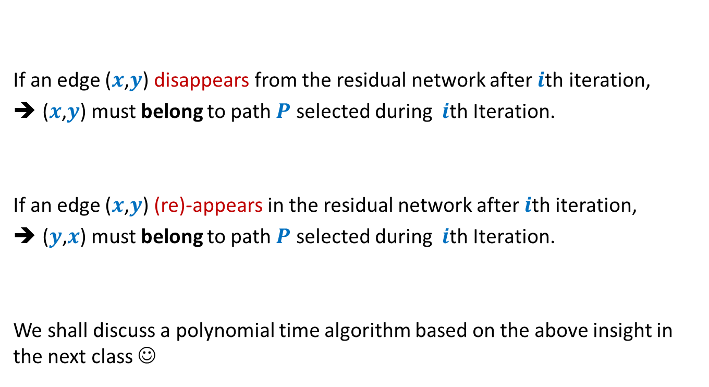
Disappearance/Reappearance of an edge in residual network
If an edge ($x$,$y$) disappears from the residual network after $i$th iteration,
($x$,$y$) must belong to path $P$ selected during $i$th Iteration.
If an edge ($x$,$y$) (re)-appears in the residual network after $i$th iteration,
($y$,$x$) must belong to path $P$ selected during $i$th Iteration.
We shall discuss a polynomial time algorithm based on the above insight in the next class ☺

Slide 18


Algorithm 2
Ford-Fulkerson-algo($G$,$s$,$t$) {
$f$← $0$;
While (there is $s$-$t$ path in $G_{f}$) do
{ Let $P$ be an $s$-$t$ path in $G_{f}$
Let$c′$ be bottleneck capacity of $P$;
For each ($x$,$y$) $∈P$ do
{ If ($x$,$y$) is a forward edge then
$f$($x$,$y$) ← $f$($x$,$y$) + $c′$;
Else
$f$($y$,$x$) ← $f$($y$,$x$) - $c′$;
}
} return $f$;
}
Algorithm-2($G$,$s$,$t$) {
Let $P$ be the shortest $s$-$t$ path in $G_{f}$;

Slide 19

Analysis of Algorithm 2
Lemma: Whenever an edge ($x$,$y$) re-appears in residual network,
distance of $x$ from $s$ increases by at least $2$ units.
Homework

Slide 20
Integrality of max-flow
A useful tool for many applications of Max-Flow

Slide 21




Integrality of max-flow
Theorem: Given a network $G$=($V$,$E$), and two vertices $s$,$t∈V$,
if edge capacities are integers, then there exists a maximum $s$-$t$flow $f$
which is “integral”.
$f\left(e\right)∈Z$for each $e∈E$
1
.67
1
.67
1
1
1
$$s$$
1
.33
$$t$$
0
.33
0
1
1

Slide 22
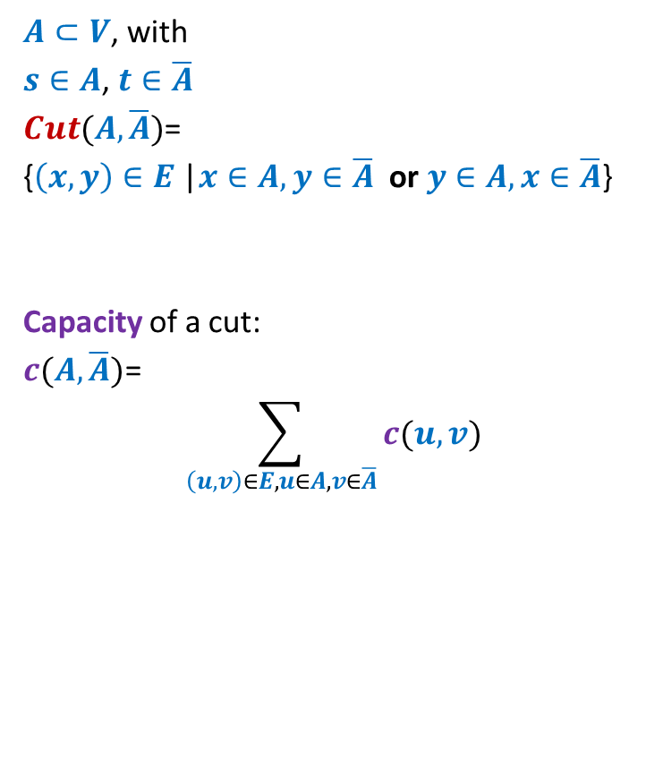

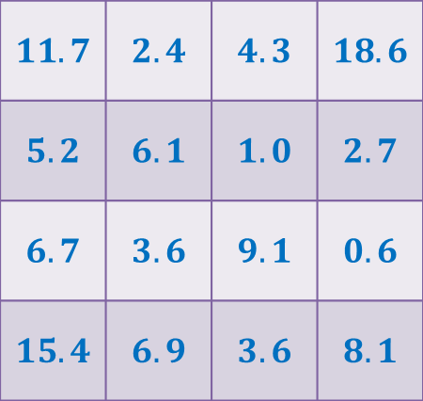

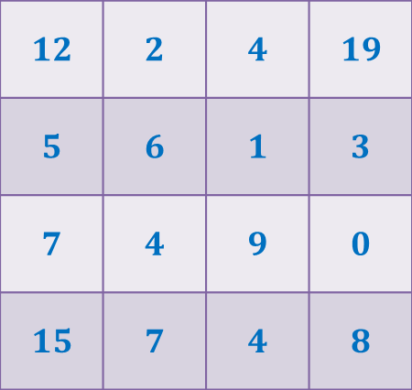
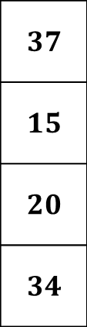
Rounding of a matrix
$$11$$
$$11.7$$
$$12$$
$$39$$ | $$19$$ | $$18$$ | $$30$$
$$37$$
$$15$$
$$20$$
$$34$$
$$11.7$$ | $$2.4$$ | $$4.3$$ | $$18.6$$
$$5.2$$ | $$6.1$$ | $$1.0$$ | $$2.7$$
$$6.7$$ | $$3.6$$ | $$9.1$$ | $$0.6$$
$$15.4$$ | $$6.9$$ | $$3.6$$ | $$8.1$$
$$12$$ | $$2$$ | $$4$$ | $$19$$
$$5$$ | $$6$$ | $$1$$ | $$3$$
$$7$$ | $$4$$ | $$9$$ | $$0$$
$$15$$ | $$7$$ | $$4$$ | $$8$$
Rounding always exists !
Rounding can be computed efficiently.

Slide 23

Rounding of a matrix
Tool 1: Integrality of max-flow
Tool 2: An elementary observation
Max-Flow can not decrease if we increase the capacity of any set of edges.
Tool 3: A simple Homework exercise
If each matrix with entries $∈[0,1]$ can be rounded,
then each matrix can be rounded.
Homework

Slide 24
Application # 1 of Max-Flow
Bipartite Matching

Slide 25
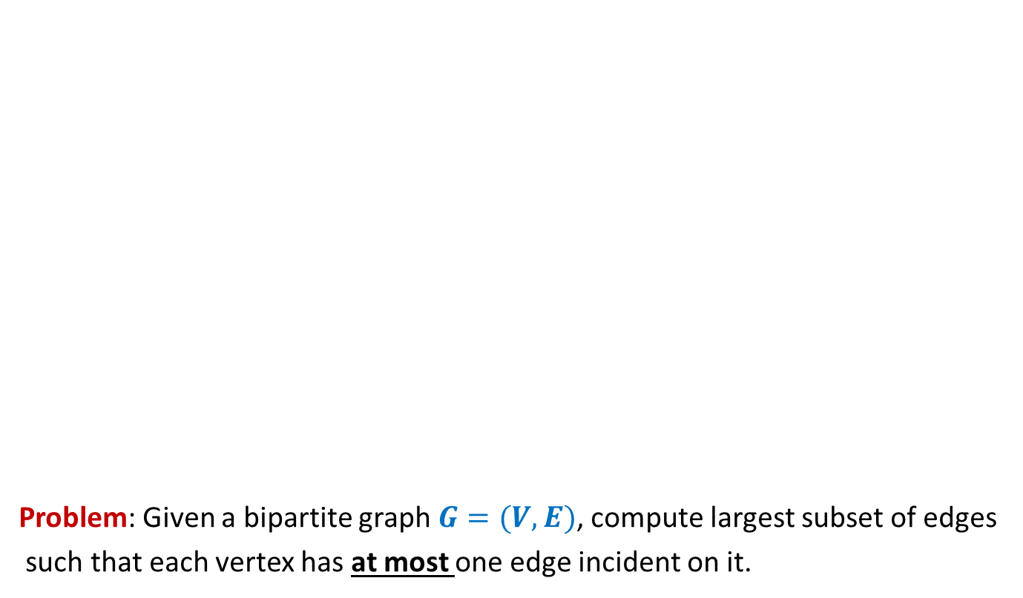
Bipartite matching
Problem: Given a bipartite graph $G=(V,E)$, compute largest subset of edges
such that each vertex has at most one edge incident on it.
applicants
jobs
Matching of size 5
Matching of size 3

Slide 26







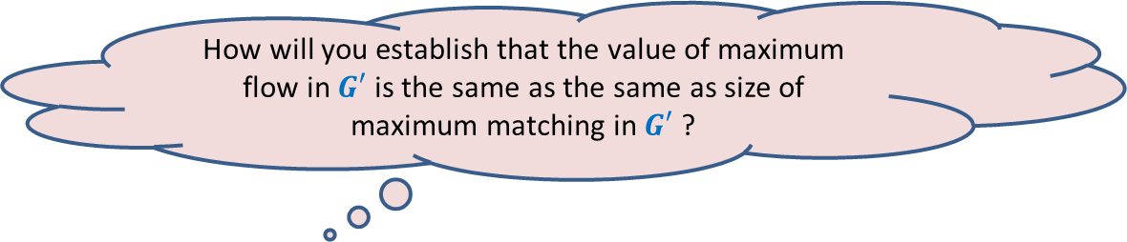
Bipartite matching Maximum Flow
How to extract the matching from the max-flow ?
How does the max-flow instance look like ?
applicants
jobs
$$1$$
$$1$$
$$1$$
$$1$$
$$1$$
$$1$$
$$1$$
Homework
$$1$$
$$G′$$
$$s$$
$$1$$
$$t$$
$$1$$
$$1$$
$$1$$
$$1$$
$$1$$
$$1$$
$$1$$
$$1$$
$$1$$
$$1$$
$$1$$
$$1$$
$$1$$
$$1$$
How will you establish that the value of maximum flow in $G′$ is the same as the same as size of maximum matching in $G′$ ?

Slide 27

Application # 2 of Max-Flow
Maximum no. of Edge Disjoint paths from $s$ to $t$

Slide 28
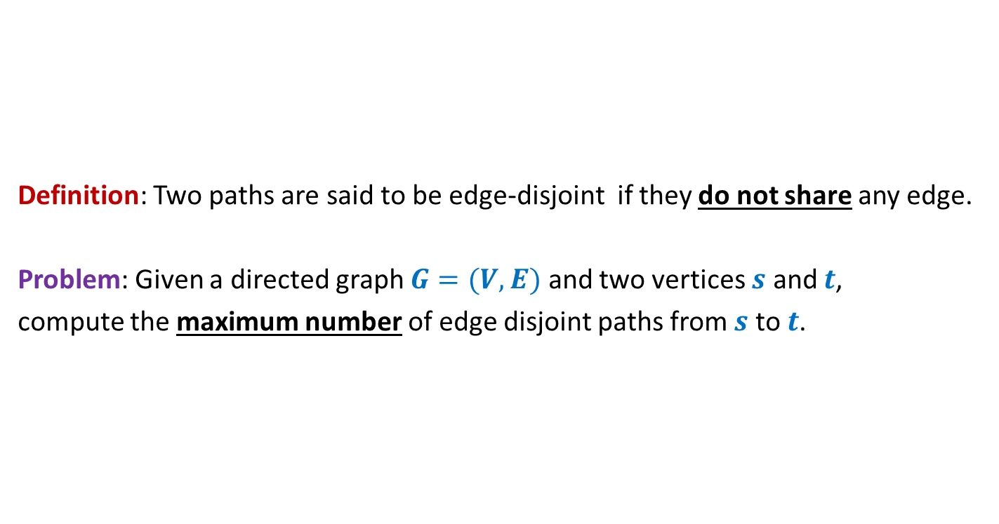

Maximum no. of Edge Disjoint paths from $s$ to $t$
Definition: Two paths are said to be edge-disjoint if they do not share any edge.
Problem: Given a directed graph $G=(V,E)$ and two vertices $s$ and $t$,
compute the maximum number of edge disjoint paths from $s$ to $t$.

Slide 29
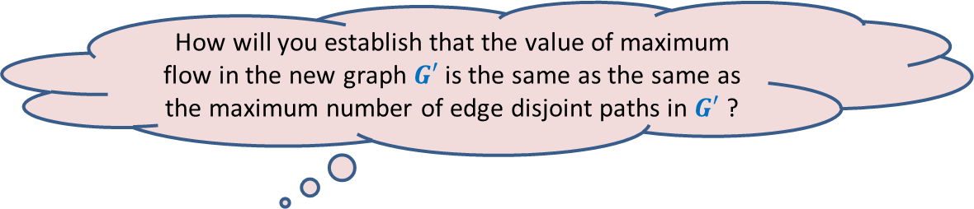



Maximum no. of Edge Disjoint paths from $s$ to $t$
$$G$$
$$s$$
$$t$$
Homework
How does the max-flow instance look like ?
How to extract the edge disjoint paths from the max-flow ?
How will you establish that the value of maximum flow in the new graph $G′$ is the same as the same as the maximum number of edge disjoint paths in $G′$ ?

